Slide 1
DevOps

Slide 2
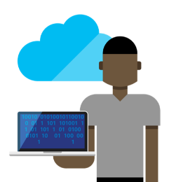

What is DevOps?
“DevOps is the next step in the evolution of Agile and ALM”
Agile:
How do I develop the “right” software?
DevOps:
How do I deliver software faster?
Business
IT Ops
Developers
ALM:
How do I develop software with quality?
Notes:
Talking Points:
Agile = In the beginning, we were trying to solve the problem of “how do I build the right software?”
Brings together the business teams and the development teams.
Focus on building software that creates value
Ability to change and adapt
ALM (Application Lifecycle Management) = Once we got good at building the right software…then we needed to scale our capabilities across the organization which then posed the problem of “how do we develop software with quality?”
As Agile teams matured and scaled, we needed ways to ensure consistency and quality
How do we view a portfolio of work across dozens of Agile teams? (TFS, VSTS)
How do we ensure we are building testable requirements?
DevOps = Now that we can deliver the right software, with Quality, we are now faced with the problem of “how do I deliver the software faster”?
This is what we will explore throughout the rest of the session today…

Slide 3
What does DevOps look like?

Slide 4
What does DevOps Look like?
The shift to DevOps
OLD WORLD
Focus on planning
Compete, not collaborate
Static hierarchies
Individual productivity
Efficiency of process
Assumptions, not data
Estimating performance
NEW WORLD
Focus on delivering
Collaborate to win
Fluent and flexible teams
Collective value creation
Effectiveness of outcomes
Experiment, learn and respond
Measuring performance
Notes:
Talking Points:
Planning vs. Delivering
We know that we cannot define an entire product backlog upfront with a new or existing application. We need to start shifting our focus from this initial planning to delivering the software and then learning how it is being used.
Compete vs. Collaborate
We are not competing with internal business teams, we all need to be working together for a common goal.
Static vs. Flexible
We need to break down the silos of static roles and form more cohesive, cross functional teams that will pick up “what’s next” for work items help deliver the value to the business.
Productivity vs. Value
We should be measured by what our team is able to accomplish as a group rather than how many lines of code I write or how many bugs are found.
As we mentioned in the “Team R and Team D” storyline, we need to measure what is important which is value delivered to the business.
Efficiency vs. Effectiveness
Efficiency is important but making sure we are always aimed and the right business outcomes is what makes that efficiency really valuable.
Assumptions vs. Learning
It is natural in software design and development to try and predict how it might be used but generally this is based on opinion rather than what we see in production.
We need to be measuring how our software is actually working and being used in production and them let that information help drives us in the right direction.
Estimating vs. Measuring
We can guestimate how we think the software will perform but until we see it in production we really cannot truly measure the performance.

Slide 5

What does DevOps look like?
Unified Backlog
Operational
Deliverables
Production
Experimentation
& Monitoring
Requirements
Delivery Teams
Development
Collaboration
Production
Feedback
Loops
Application-driven
Infrastructure
Notes:
Talking Points:
How does DevOps look from a team perspective?
Integrated Delivery Teams – Business, Development, Testing, and Operations all working together
Unified Backlog – we are all working towards a common goal and prioritize business features with operational support items
Feedback Loops – incorporating business vision, operational performance, customer feedback, market conditions to drive product development
Operational Deliverables – build out of environments, NFR’s, and monitoring are all work items that contribute to the overall deliverable; these need to be part of the unified backlog.
Production Experimentation & Monitoring – Feature flags, soft roll outs, fail forward & Application Monitoring
Application Driven Infrastructure – allow applications to drive the hardware and software requirements needed rather than having it “fit” into a shared server model. This allows for maximum efficiency in delivering software.

Slide 6



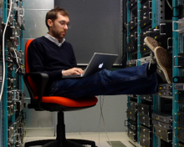
What does DevOps Look like?
What does it mean for me?
Business Teams
Developers
Testers
Operations
Tech Debt Matters
You build it, you run it
Automation is a must
Apps drive infrastructure
Learn from Customers
Code for operations
Test quality not just quantity
Scripting is tool of choice
Software is never done
Testing is for everyone
Test data must be part of the strategy
We own customer experience too
Notes:
Talking Points:
Let’s now take a moment and look at what DevOps means for me and my role within a team.
Talk through each of the roles and how DevOps affects them…

Slide 7
DevOps
DevOps is the combination of cultural philosophies, practices, and tools that increases an organization's ability to deliver applications and services at high velocity: evolving and improving products at a faster pace than organizations using traditional software development and infrastructure management processes

Slide 8
Industry Importance of DevOps
DevOps helps in automating the manufacturing processes and ensuring robustness in operations. With DevOps ensuring continuous integration of activities, it helps business owners and decision makers to focus on developing new products as the daily disturbances of production are taken over by the existing teams.
Robustness means the quality or condition of being strong and in good condition.

Slide 9
Industry Importance of DevOps
Maximizes Efficiency with Automation
The late DevOps authority Robert Stroud said DevOps is all about "fueling business transformation" that involves people, process and culture change. The most effective strategies for DevOps transformation focus on structural improvements that build community. A successful DevOps initiative requires a culture—or mindset—change that brings greater collaboration between multiple teams—product, engineering, security, IT, operations and so on—as well as automation to better achieve business goals.
By managing engineering processes end to end, DevOps emphasizes deploying software more often, in a reliable and secure way through automation.

Slide 10
End-to-end describes a process that takes a system or service from beginning to end and delivers a complete functional solution, usually without needing to obtain anything from a third party.

Slide 11
Industry Importance of DevOps
Optimizes the Entire Business
System architect Patrick Debois, best known as the creator of the DevOps movement, says the biggest advantage of DevOps is the vision it provides. It forces organizations to "optimize for the whole system," not just IT siloes, to improve the business as a whole. In other words, be more adaptive and data-driven for alignment with customer and business needs.

Slide 12
Industry Importance of DevOps
Improves Speed and Stability of Software Development and Deployment
A multi-year analysis in the annual Accelerate State of DevOps Report has found that top-performing DevOps organizations do far better on software development/deployment speed and stability, and also achieve the key operational requirement of ensuring that their product or service is available to end users..

Slide 13
Industry Importance of DevOps
Gets You to Focus on What Matters Most: People
People, not tools, are the most important component of a DevOps initiative. Key roleplayers (i.e., humans) can greatly increase your odds of success, such as a DevOps evangelist, a persuasive leader who can explain the business benefits brought by the greater agility of DevOps practices and eradicate misconceptions and fears. And since automated systems are crucial to DevOps success, an automation specialist can develop strategies for continuous integration and deployment, ensuring that production and pre-production systems are fully software-defined, flexible, adaptable and highly available.

Slide 14
Challenges of DevOps
There are many challenges in a DevOps initiative. Your organization must reimagine its structure to improve the way things get done. Companies often underestimate the amount of work required in a DevOps transformation, though. According to a recent Gartner study, 75% of DevOps initiatives through 2020 will fail to meet their goals due to issues around organizational learning and change.
“Organizational learning and change are key to allowing DevOps to flourish. In other words, people-related factors tend to be the greatest challenges — not technology, ” says Gartner senior analyst George Spafford.
Choosing the Right Metrics is Hard
Enterprises transitioning to DevOps practices need to use metrics to recognize progress, document success, and uncover areas that need improvement,
Forrester notes. For example, an acceleration in deployment velocity without a corresponding improvement in quality is not a success. An effective DevOps effort needs metrics that drive smart automation decisions—and yet organizations often struggle with DevOps metrics.
So where to start? Find metrics that align with velocity and throughput success.

Slide 15
Challenges of DevOps
Limited Funds
DevOps initiatives face other obstacles as well. Given the significant organizational and IT changes involved—with previously siloed teams joining forces, changing job roles, and encountering other transitions— adjustments will take time. According to a survey of IT executives from software company Pensa, the top challenges to DevOps success are:
Limited budgets (cited by 19.7% of respondents)
Legacy systems (17.2%)
Application complexity (12.8%)
Difficulty managing multiple environments (11.3%)
Company culture (9.4%)
Complexity

Slide 16
The Future of DevOps
The future of DevOps will likely bring changes in tooling and organizational strategies, but its core mission will remain the same
Automation Will Play a Major Role
Automation will continue to play a major role in DevOps transformation, and artificial intelligence for IT operations—AIOps—will help organizations achieve their DevOps goals. The core elements of AIOps—machine learning, performance baselining, anomaly detection, automated root cause analysis (RCA) and predictive insights—work together to accelerate routine operational tasks. This emerging technology, which can transform how IT operations teams manage alerts and resolve issues, will be a crucial component of the future of DevOps.
AIOps Will Make Service Uptime Easier to Achieve
In addition to using data science and computational techniques to automate mundane tasks, AIOps also ingests metrics and uses inference models to pull actionable insights from data, notes data science architect Jiayi Hoffman. AIOps' automation capabilities can make service uptime much easier to achieve, from monitoring to alerting to remediation. And AIOps is a boon for DevOps teams, who can use AIOps tools for real-time analysis of event streams, proactive detection to reduce downtime, improved collaboration, faster deployments, and more.
Will Sharpen Focus on Cloud Optimization
The future of DevOps will also bring a greater focus on optimizing the use of cloud technologies. The centralized nature of the cloud provides DevOps automation with a standard platform for testing, deployment, and production notes Deloitte Consulting analyst David Linthicum.
And regardless of what advanced technologies the future brings, organizations will need to realize that DevOps is all about the journey and that the organization's DevOps-related goals and expectations will evolve over time.

Slide 17
DevOps Lifecycle
DevOps defines an agile relationship between operations and Development. It is a process that is practiced by the development team and operational engineers together from beginning to the final stage of the product.

Slide 18
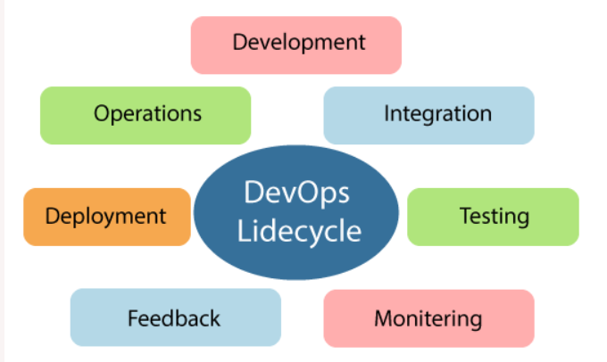

Slide 19
The DevOps lifecycle includes seven phases as given below:
1) Continuous Development
This phase involves the planning and coding of the software. The vision of the project is decided during the planning phase. And the developers begin developing the code for the application. There are no DevOps tools that are required for planning, but there are several tools for maintaining the code.
2) Continuous Integration
This stage is the heart of the entire DevOps lifecycle. It is a software development practice in which the developers require to commit changes to the source code more frequently. This may be on a daily or weekly basis. Then every commit is built, and this allows early detection of problems if they are present. Building code is not only involved compilation, but it also includes unit testing, integration testing, code review, and packaging.

Slide 20
The code supporting new functionality is continuously integrated with the existing code. Therefore, there is continuous development of software. The updated code needs to be integrated continuously and smoothly with the systems to reflect changes to the end-users.
Jenkins is a popular tool used in this phase. Whenever there is a change in the Git repository, then Jenkins fetches the updated code and prepares a build of that code, which is an executable file in the form of war or jar. Then this build is forwarded to the test server or the production server.

Slide 21
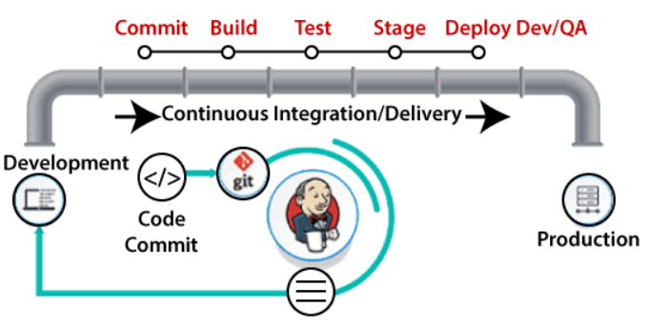

Slide 22
3) Continuous Testing
This phase, where the developed software is continuously testing for bugs. For constant testing, automation testing tools such as TestNG, JUnit, Selenium, etc are used. These tools allow QAs to test multiple code-bases thoroughly in parallel to ensure that there is no flaw in the functionality. In this phase, Docker Containers can be used for simulating the test environment.

Slide 23
Selenium does the automation testing, and TestNG generates the reports. This entire testing phase can automate with the help of a Continuous Integration tool called Jenkins.
Automation testing saves a lot of time and effort for executing the tests instead of doing this manually. Apart from that, report generation is a big plus. The task of evaluating the test cases that failed in a test suite gets simpler. Also, we can schedule the execution of the test cases at predefined times. After testing, the code is continuously integrated with the existing code.

Slide 24
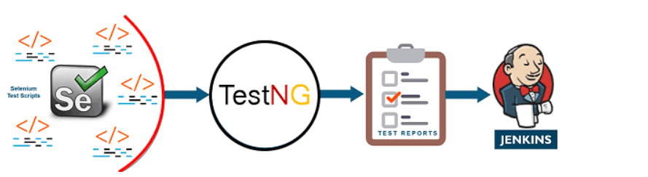

Slide 25
Some developers carry out the continuous testing phase prior to the continuous integration phase. Based on the updations in the application code, this phase can be repositioned around the continuous integration phase in the DevOps lifecycle. Here, the developed software is continuously tested for bugs. A test environment is simulated with the use of Docker containers.
Through automated testing, developers save effort and time, usually lost in manual testing. Reports generated by automated testing improve the test evaluation process. Analyzing the failed test-cases becomes easy. After going through a UAT (User Acceptance Testing) process, the resultant testsuite is simpler and bug-free. TestNG, Selenium and JUnit are some of the DevOps tools used for automated testing. These tools can also arrange test-case execution in a preset timeline

Slide 26
4) Continuous Monitoring
Monitoring is a phase that involves all the operational factors of the entire DevOps process, where important information about the use of the software is recorded and carefully processed to find out trends and identify problem areas. Usually, the monitoring is integrated within the operational capabilities of the software application.
It may occur in the form of documentation files or maybe produce large-scale data about the application parameters when it is in a continuous use position. The system errors such as server not reachable, low memory, etc are resolved in this phase. It maintains the security and availability of the service.

Slide 27
Monitoring the performance of an application is of key importance for application developers. In this phase, developers record data on the use of application and continuously monitor each functionality.
“Server not reachable” or “low memory” are some of the common system errors resolved in this phase. Continuous monitoring helps in sustaining the availability of services in the application. It also determines the threats and root causes of recurring system errors. Security issues get resolved and problems are automatically detected and fixed.

Slide 28
Compared to the software development teams, the IT operations teams are more involved in this phase. Their role is pivotal in supervising user activity, checking the system for unusual behavior, and tracing the presence of bugs.
Sensu, ELK Stack, NewRelic, Splunk and Nagios are the key DevOps tools used in continuous monitoring. These tools enable complete control in overseeing the performance of the system, the production server, and the application. The operations team can actively engage in increasing the reliability and productivity of the applications with the help of these tools.

Slide 29
When major issues are detected in this phase, the application is swiftly rerun through all the earlier phases of the DevOps lifecycle. That is how finding a resolution to all sorts of issues becomes faster in this phase
The last phase of the DevOps life cycle is the shortest phase and the least complicated one. The purpose of continuous operation is to automate the process of releasing the application and the subsequent updates. Development cycles in continuous operations are shorter, allowing developers to ongoing accelerate the time-to-market for the application.

Slide 30
5) Continuous Feedback
The application development is consistently improved by analyzing the results from the operations of the software. This is carried out by placing the critical phase of constant feedback between the operations and the development of the next version of the current software application.
The continuity is the essential factor in the DevOps as it removes the unnecessary steps which are required to take a software application from development, using it to find out its issues and then producing a better version. It kills the efficiency that may be possible with the app and reduce the number of interested customers.

Slide 31
Continuous testing and continuous integration are the two crucial phases that ensure consistent improvements in the application code. Continuous feedback is a peculiar phase where these improvements are analyzed.
Developers can scale the outcome of these modifications on the final product. Most importantly, customers who tested these applications can share their experiences in this phase. In a majority of cases, this phase of the DevOps lifecycle provides a turning point to the application development process.

Slide 32
The feedback is assessed promptly and developers begin working on the new changes. Sooner, there is a positive response in customer feedback, which covers the way for releasing new versions of the software application.

Slide 33
6) Continuous Deployment
In this phase, the code is deployed to the production servers. Also, it is essential to ensure that the code is correctly used on all the servers.

Slide 34
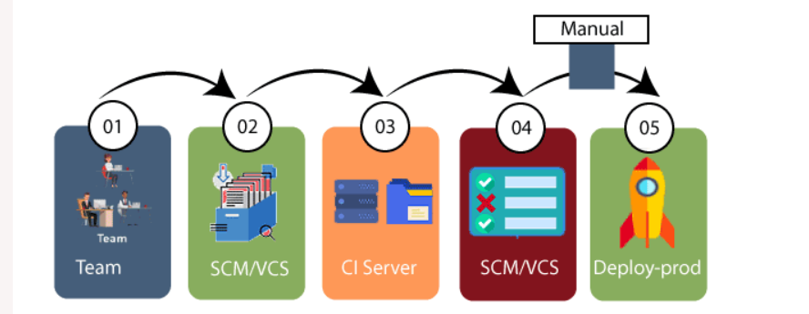

Slide 35
The new code is deployed continuously, and configuration management tools play an essential role in executing tasks frequently and quickly. Here are some popular tools which are used in this phase, such as Chef, Puppet, Ansible, and SaltStack.
Containerization tools are also playing an essential role in the deployment phase. Vagrant and Docker are popular tools that are used for this purpose. These tools help to produce consistency across development, staging, testing, and production environment. They also help in scaling up and scaling down instances softly.
Containerization tools help to maintain consistency across the environments where the application is tested, developed, and deployed. There is no chance of errors or failure in the production environment as they package and replicate the same dependencies and packages used in the testing, development, and staging environment. It makes the application easy to run on different computers.

Slide 36
7) Continuous Operations
All DevOps operations are based on the continuity with complete automation of the release process and allow the organization to accelerate the overall time to market continuingly.
It is clear from the discussion that continuity is the critical factor in the DevOps in removing steps that often distract the development, take it longer to detect issues and produce a better version of the product after several months. With DevOps, we can make any software product more efficient and increase the overall count of interested customers in your product.

